Slide 1
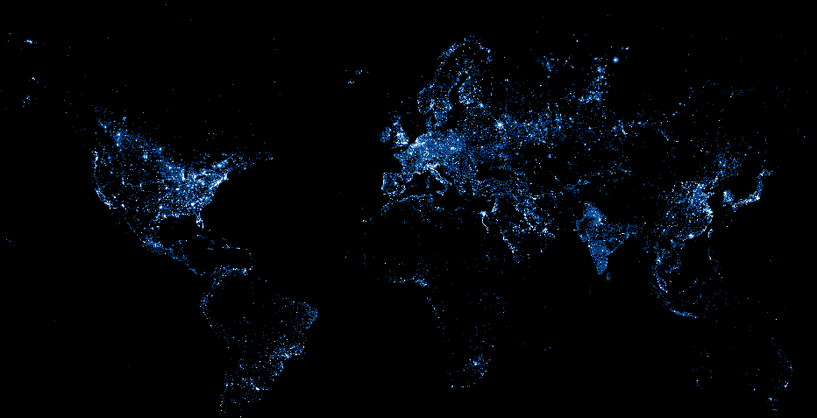
Using Night Lights to Measure Economic Growth
Peter Rasmussen

Slide 2
Issue: Data gaps in emerging markets
GDP
Syria
Afghanistan
Somalia
Notes:
Traditional means of getting socioeconomic data can be imprecise or unavailable
It can be difficult to get estimates for cities and conflict and post-conflict areas
GDP data is valuable to governments, local companies, multi-nationals, and the aid industry
Unfortunately, the best data is often locked behind paywalls

Slide 3
Issue: Data gaps in emerging markets
GDP
Syria
Afghanistan
Somalia
Notes:
Traditional means of getting socioeconomic data can be imprecise or unavailable
It can be difficult to get estimates for cities and conflict and post-conflict areas
GDP data is valuable to governments, local companies, multi-nationals, and the aid industry
Unfortunately, the best data is often locked behind paywalls

Slide 4
Issue: Data gaps in emerging markets
How do we measure economic growth in places where statistics are imprecise or unavailable?

Slide 5
Hypothesis
We can use satellite night light imagery to measure GDP
Notes:
Fill in the gaps

Slide 6
Hypothesis
Syria
Afghanistan
Somalia
Notes:
Here we see night

Slide 7
Methodology
Notes:
Data from NOAA: 1992 to 2013
250 country-level linear regressions to model how light intensity correlates with given country’s GDP

Slide 8
Results: Country-Level Regressions
0.05
0.91

Slide 9
Results: Country-Level Regressions
Emerging markets tend to correlate to light better than developed / industrialized markets
Notes:
Correlation for developed / industrialized countries may be poorer because they are already electrified

Slide 10
Results: City-Level Regressions
Chart comparing these estimates against PwC, other estimates for top emerging market metros

Slide 11
Thank You!
Blog
pgr-me.github.io
peter.gray.rasmussen@gmail.com
pgr-me
petergrayrasmussen

